Slide 1
IDRC Open Data Case Study: Opening access to economic data to prevent alcohol and tobacco related diseases in African countries
Photo: Jade Gibson, 2014

Slide 2
Project Background and Motivation
Alcohol and tobacco related diseases require public health action. Effective public policies need sound analyses based on reliable data.
African governments generate relevant data – on:
• Alcohol and tobacco use
• Prevalence of alcohol and tobacco related diseases
• Tobacco control measures, taxation
However, this is not routinely made available online or in research-ready formats. The Project will address this by sourcing and publishing this data to allow evidence-informed, policy research for alcohol and tobacco control measures

Slide 3
Aim of the Project
To broaden access to existing alcohol and tobacco data
To increase awareness of available data
To encourage research in the field
The focus will be on economic data e.g.data on tobacco prices and taxes (revenue). Consumption data will also be collected.
DataFirst is a research data service based at the University of Cape Town and will help the Project source data in three African countries and will make this available
Time series data – to examine changes over time
Cross-sectional data – to obtain precise measurements
Panel survey data – for both

Slide 4
Why participate in the pilot Open Data programme?
Placing data in the public domain is an agreed Project output
Challenges will be around access and permissions, as well as data quality control
These are not unique to African countries – only exacerbated by skills and infrastructure constraints in some countries
Lessons learned can be shared through the pilot study to inform future attempts to widen access to African policy and health data
Will also inform the IDRC’s Open Data work and policies

Slide 5
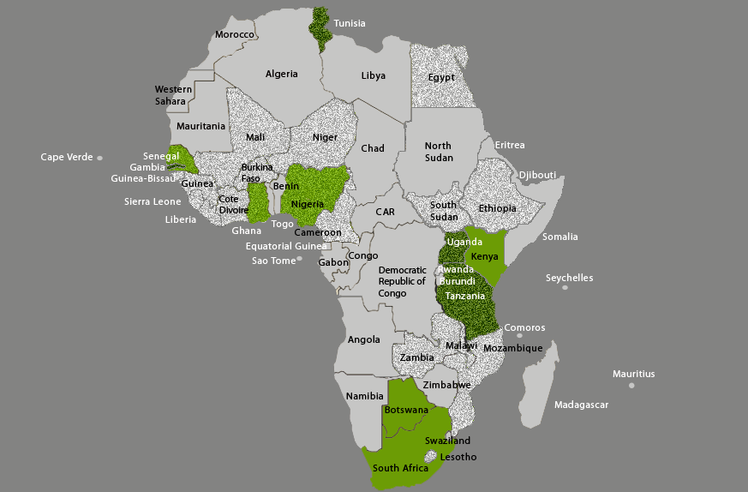
Questions? www.datafirst.uct.ac.za
Lynn Woolfrey 2013

