Slide 1
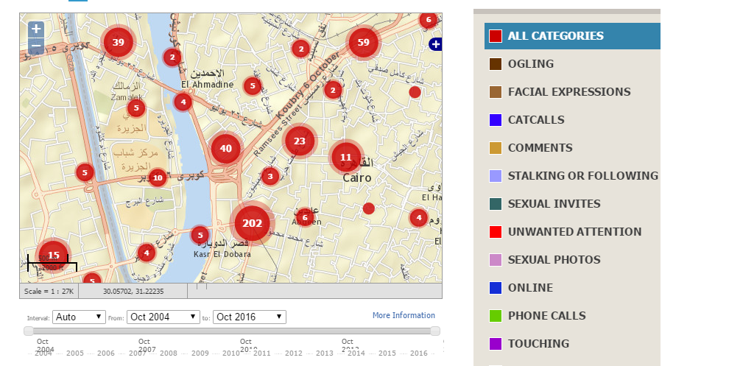
The Map

Slide 2
Crowdsourced Data
Research Analysis and Reports
Campaigns and Trainings

Slide 3
We are participating in this project because…
We want to better utilize our data in academia so as to analyze cross-cutting themes of sexual harassment
We want to help researchers and make it easier for them to use our data but protect our copy right
We want to have an easier way to store out data

