Slide 1
Small Enterprise Monitoring Surveys
Enhancing the Capacity of the Economic Committee
of the National Assembly of Vietnam
Dr. Le Dang Trung
Chief Economist
Collaborating with the Vietnamese Academy of Social Sciences (VASS)
Real-Time Analytics Head Office
Suite 1101, Citilight Tower
45 Vo Thi Sau, Da Kao Ward
District 1, Ho Chi Minh City, Vietnam
Tel: +84 8 6684 4030
Email: info@rta.vn
Website: www.rta.vn
03 - 2016

Slide 2
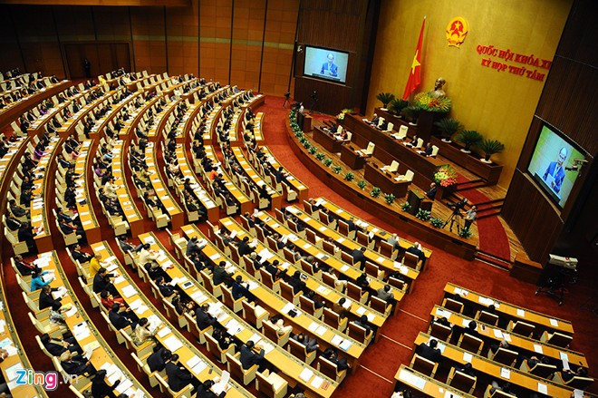
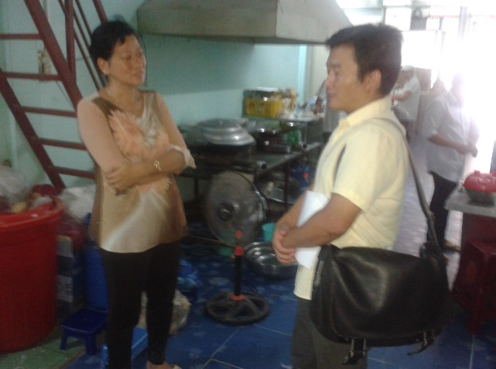
Background
Policy-making
Lack of effective coordination between agencies focused on growth vs welfare
Lack of timely and credible data on performance and health of small enterprises
Project objectives:
General objective: Make economic growth more inclusive by enhancing the capacity of the Economic Committee of the National Assembly (ECNA) to address concerns of small entrepreneurs.
Specific objectives: Increase information access for ECNA with high-frequency tablets-based data collections on easy-to-collect indicators on the performance of small and medium enterprises (SME) and labor market outcomes of their workers.
Expected outputs:
High-frequency survey data on easy-to-collect indicators
Regular policy analysis reports
Special policy reports as inputs into new draft law on SMEs

Slide 3
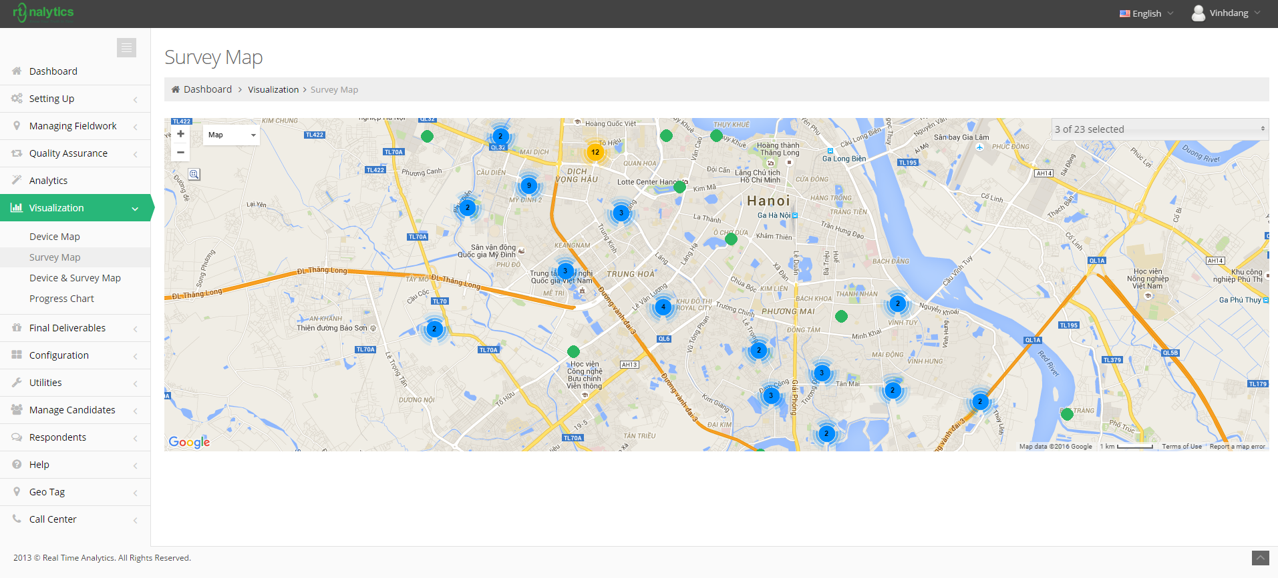
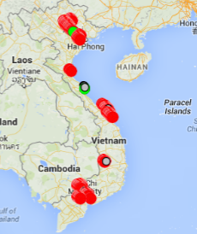
Baseline Survey
Timeline: Sep-Oct, 2014
Sampling: 776 SMEs in 12 provinces, 8 industries and 5 ownership categories
Questionnaire: Very detailed, face-to-face interviews using Smart Survey

Slide 4
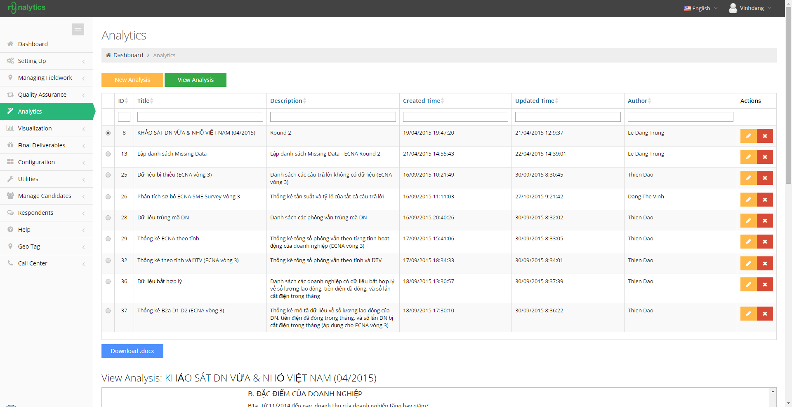
Follow-up Surveys
First Follow-up Survey
Timeline: 3 weeks in Apr, 2015
Purpose: ECNA Meetings - May 2015
Technology: Smart Survey & Real-Time reports
Second Follow-up Survey
Timeline: 3 weeks in Sep, 2015
Purposes: ECNA’s Meetings -Oct 2015
Technology: Smart Survey & Real-Time reports

