Slide 1
OCSDNet Project: The Impact of Brazil’s Virtual Herbarium in e-Science
Dora Ann Lange Canhos
Centro de Referência em Informação Ambiental
dora@cria.org.br

Slide 2
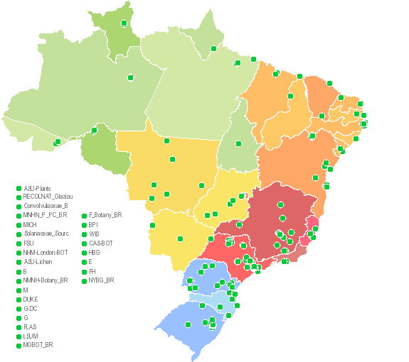
Network integrating 176 datasets
Free & open access to
>5 million textual records
>1 million images
Tools

Slide 3
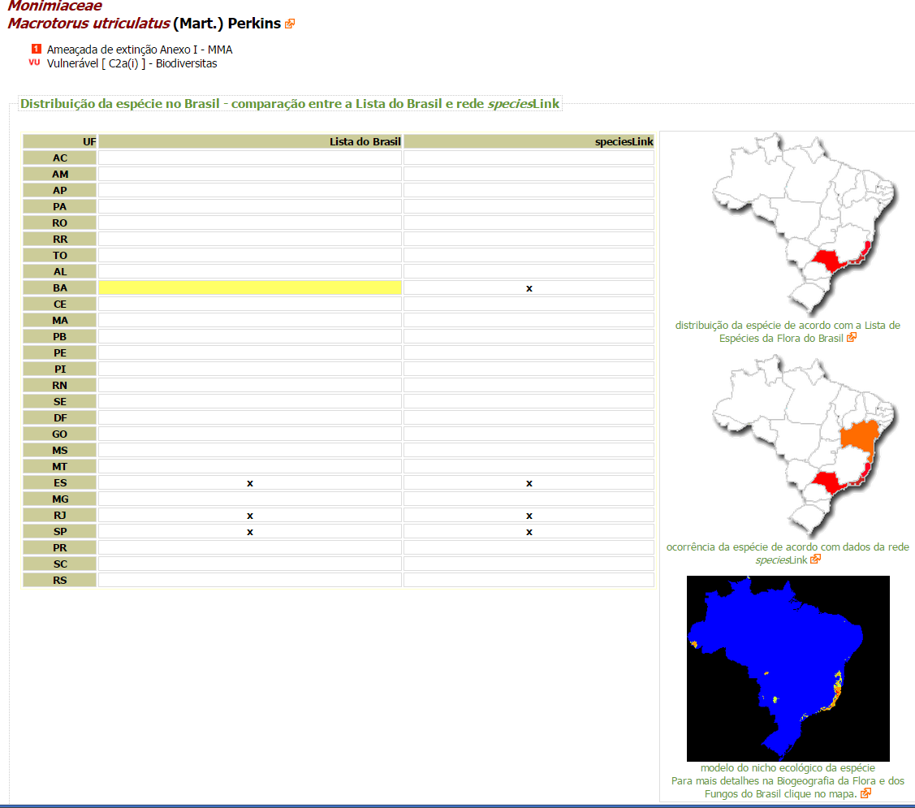
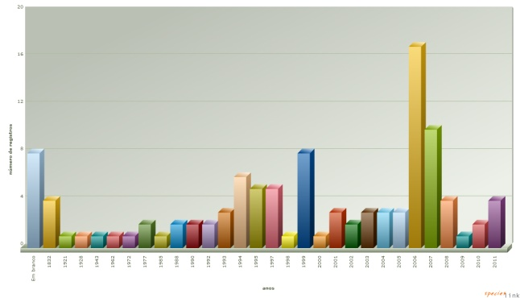
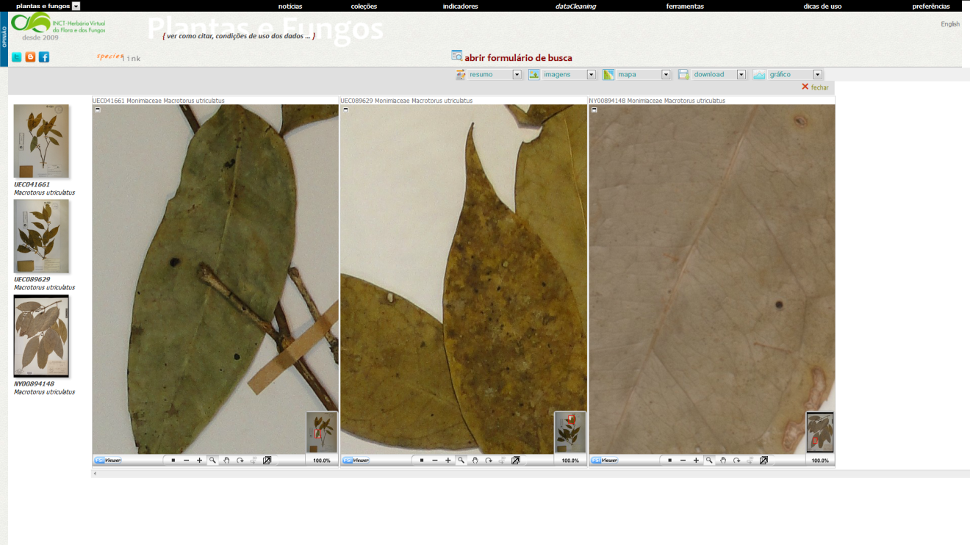
Search interface speciesLink

Slide 4
OCSDNet project
Identify drivers and outcomes of data sharing and open collaboration through BVH
Analysis: data providers, network collaborators
Quantify and qualify usage (who, what for) - 2016

Slide 5
Usage 2015 – Virtual Herbarium
On-line
~ 5.2 million records
Matches
3.5 billion records
Utilized
401 million records
(~76 times on-line)

Slide 6
When, why is data not open?
8,238 records have blocked geographic coordinates
1.8 million records off-line

Slide 7
Challenges to address
Sustainability of e-infrastructures: from project based to long term support
Governance mechanisms for Virtual Institutes
Evaluation by funding agencies of data services (data curation and data sharing through open platforms)

