Slide 1
HarassMap’s Data Management Project
By
Reem Wael
Director, HarassMap

Slide 2
Data Management Plan
Organizing all information that we accumulated in the last five years and share on an online server with interested researchers.
1. Field reports – such as outreach reports, reports from events
2. Crowdsourced reports
3. Social media content – posts, messages and comments
4. Feedback from trainings
5. Photos and videos created by HarassMap

Slide 3
HarassMap Online

Slide 4
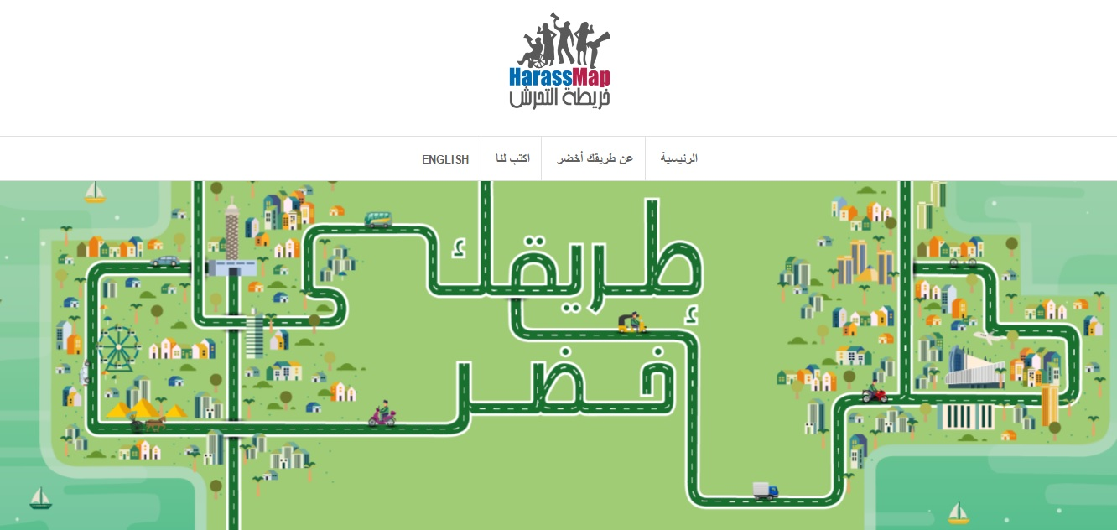

Slide 8
Successes & lessons learned
1. Data collection and storage was a very useful experience because we were not aware of the amount of data that we have.
2. It is much easier to collect and store data as we receive it than retrospectively.
3. Seeing all the data categorized enables us to do some research on the changing attitudes towards sexual harassment throughout the last five years.

Slide 9
Challenges
Ethical issues and control over data usage
Linguistic
Technical assistance
Interest in the data

Slide 10
Thank You
Reem Wael
@Reem_Wael
Reem.Wael@harassmap.org

