Slide 1
Empowering Indigenous Peoples and Knowledge Systems Related to Climate Change and Intellectual Property Rights: Reflections on Open Data Requirements Dr. Cath Traynor
2016 / 12/1 IDRC Data Sharing Pilot Wrap-Up Workshop 1-2 December, 2016, Ottawa, Canada
cath@naturaljustice.org.za / www.naturaljustice.org

Slide 2
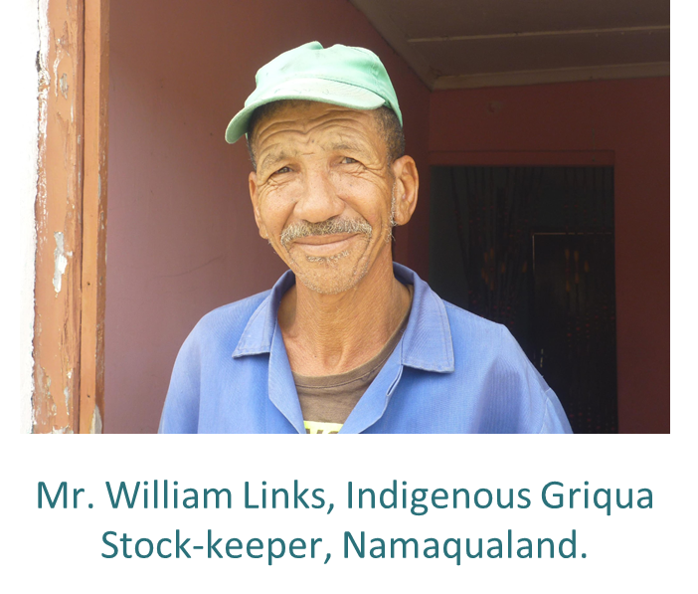
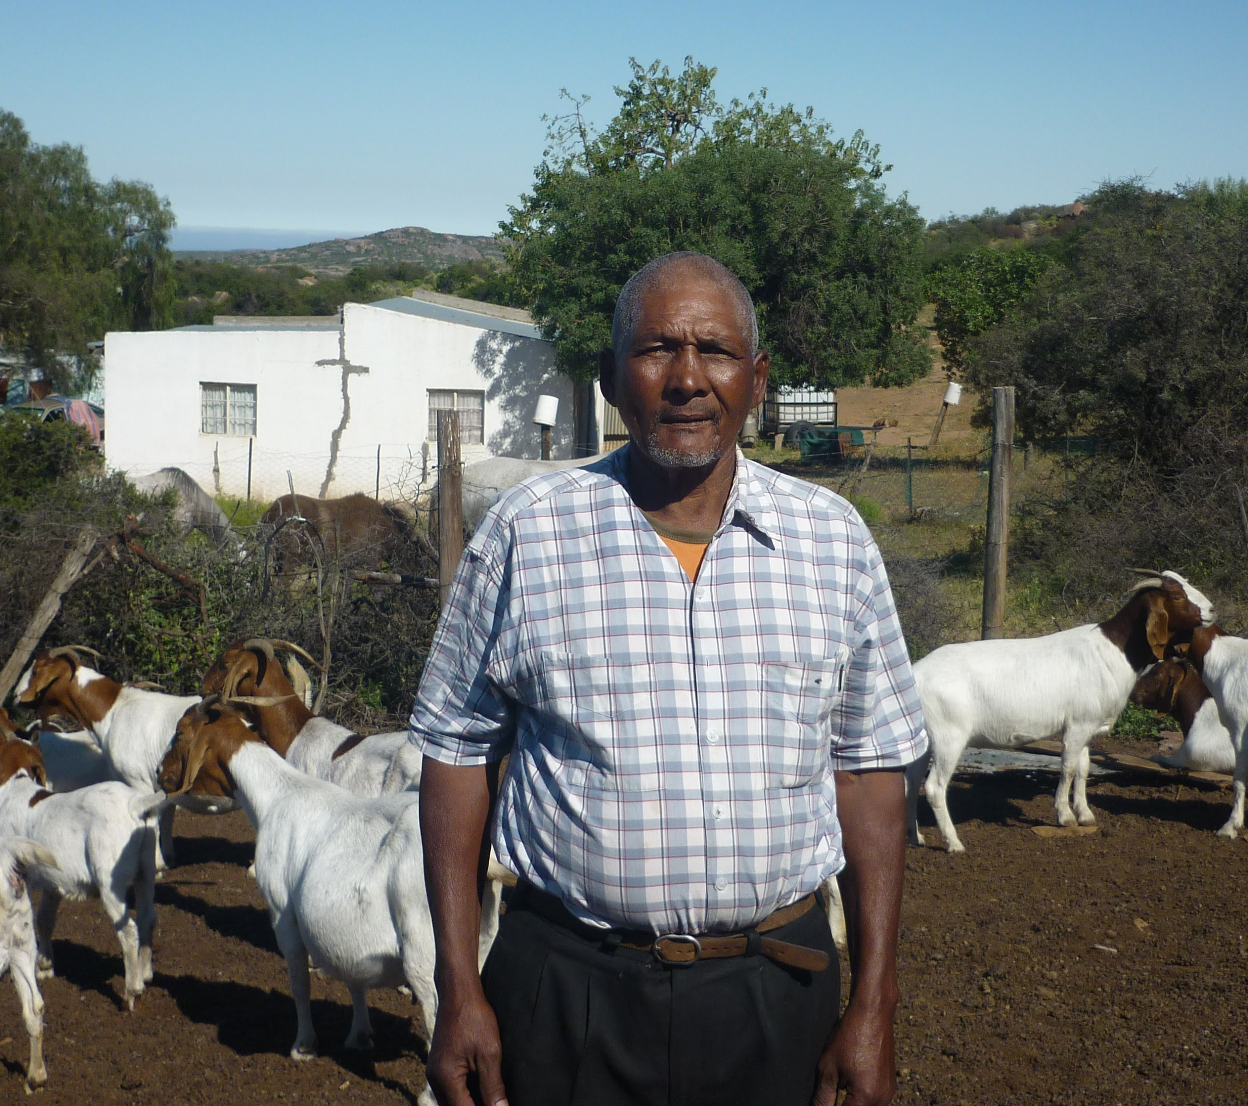
Project Context
Indigenous Peoples Histories
Colonization
Apartheid
Lands and knowledge ‘free’ for the taking: Terra Nullis
Student movements #RhodesMustFall and #FeesMustFall
Mr. Jan Stephens, Indigenous Griqua & Former Pastoralist
Critically engaged in ‘open and collaborative science’ concepts;
The research process: ethics requirements & accountability of researchers and their institutions to indigenous peoples
International and national laws and policies on IK
‘Community-Researcher Contracts’ - private law – what protection does this offer communities sharing their IK?

Slide 3
The DMP Process: Key Points
Focus on indigenous Knowledge ‘data’
Open data not planned at the start of the research process – we have consent to share results – not data.
Sharing & Re-Use: Issues – population small – annonymisation impossible? IK is collectively held – IRB/REC ‘ICDs’ working assumption is that knowledge is individually held.
End User License: ‘ICDs’ – limit access. Community-Researcher Contracts to specify who hold IPR.
Ethics & Legal Compliance: Community consent required. IPR issues. FPIC – risks – especially future. SA IKS Policy and new Act.

Slide 4
What Went Well?
DMP Logical, helps think-through open data process – if we were to share data
It breaks down ‘data’ into nice manageable objects…
Useful for project management
Useful for thinking beyond end of the project
Prompts one to consider ethical, legal issues and end-user license

Slide 5
Challenges
Working assumption of data as objects – ignores the context and histories in which IKS ‘data’ is situated
FPIC – deep understanding of the risks of sharing IK now and in the future – how to ensure fully ‘informed’?
Legal issues: SA progressive IKS policy and pending Act, but – only applicable within SA and SA citizens and legal institutional affiliations. Protections outside of SA vary, e.g. CBD
Numerous contracts (institutions, individuals) need to be in agreement and all need to state ‘open data’ upfront

Slide 6
Lessons Learned
Default open data policy – possible COI – PM/PI contractually obliged to employer & funder – not communities!
Default open data policy – responsibility falls on PM/PI –sufficient knowledge and skills concerns implications of making IKS open? – complex legal and ethical issues
Consent – individual and communal required
Default open data – an external imposition upon IPs – goes against self-determination, data sovereignty & ownership, control, access and possession (OCAP) many IPs claiming
IPS and their IKS should be exempted from open data default positions.
Policies should aim at redress and benefit for IPs.

